Slide 1
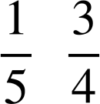
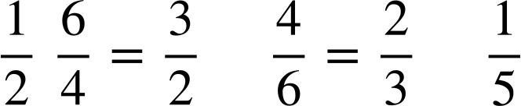
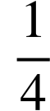
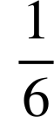
Multiplicative relationships
Task A: Connecting numbers multiplicatively
Work out the multipliers for the following pairs of numbers.
×
×
a)
2
d)
8
16
100
20
×
×
5
3
b)
3
15
e)
1.3
3.9
×
×
c)
7
f)
1
7
12
9
2) Fill in the table.
A | B | Multiplier A to B | Multiplier B to A
2 | 4
5 | 20
4 | 6
5 | 1
0.2 | 1.2
2
4
5
6

Slide 2
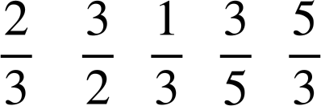

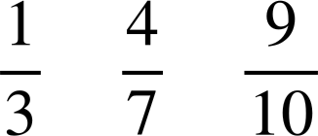

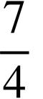
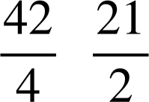
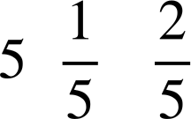
Multiplicative relationships
3) Fill in the missing multipliers.
×
×
3
4
a)
8
24
c)
23
92
×
×
24
8
92
23
×
×
b)
15
10
d)
50
30
×
×
10
15
30
50
Task B: Efficiently calculating a single multiplier
Here are functions machines with at least two multipliers.
Work out the single multiplier that connects each number.
×
×
×
5
a)
3
1
3
5
2
8
5
×
×
×
6
b)
1
6
2
8
6
×
×
×
2
c)
5
1
5
2
2
8
2

Slide 3
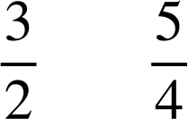

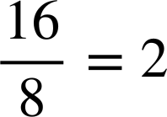
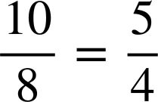

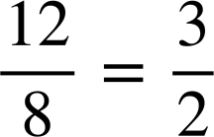
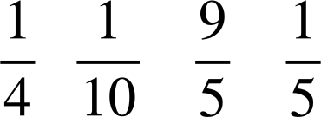
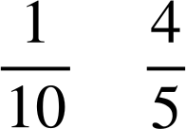
Multiplicative relationships
2) Write the number in the box to make the calculation correct. You can use the functions machines to help.
a)
8 × 2 = 16
c)
8 × = 10
×
×
16
×
×
8
1
16
10
2
8
8
1
10
2
8
Multiplier
Multiplier
b)
8 × = 12
d)
8 × = 9
×
×
×
×
9
12
8
1
9
2
8
1
12
8
2
8
Multiplier
3) Fill in the blanks.
×
×
×
9
a)
4
1
9
4
9
×
×
×
8
c)
10
1
8
10
8
Mathematics in Education and Industry
v2.3

